Slide 1

BYTE BUILDERS
UITENHAGE AIRPORT

Slide 2
Content layout
Briefly review Gantt chart
Briefly review Cut-Sheet
Review Device list & Physical Diagram
Logical Diagram and Configurations
Questions

Slide 3
GANTT CHART
This Photo by Unknown Author is licensed under CC BY-SA

Slide 4
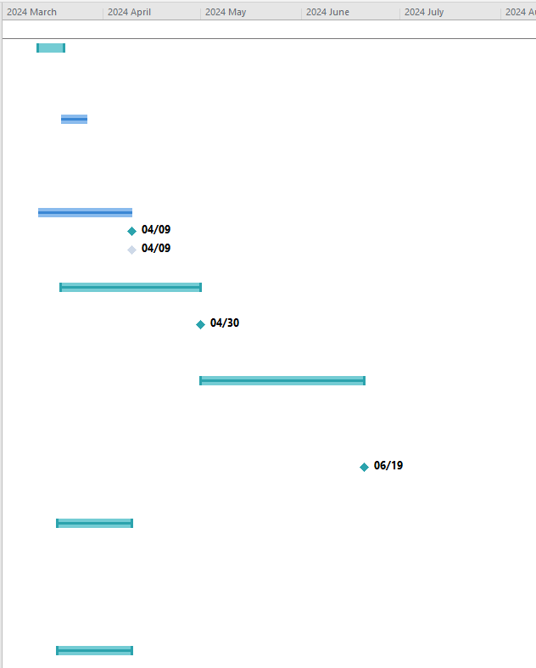
Duration
1. Planning and Design:
Task
1.1.1
1.1.2
1.1.3
1.2.1
1.2.2
1.3.1
1.3.2
1.1.1 Conduct physical site survey (2%)
1.1.2 Conduct logical site survey (2%)
1.1.3 Create the necessary Documentation(4%)
Create Device list
Create Logical topology
1.2.1 Define network topology (5%)
1.2.2 Define network architecture (5%)
Develop physical topology
1.3.1 Determine Fiber cabling requirements (2%)
1.3.2 Determine copper cabling requirements (2%)

Slide 5
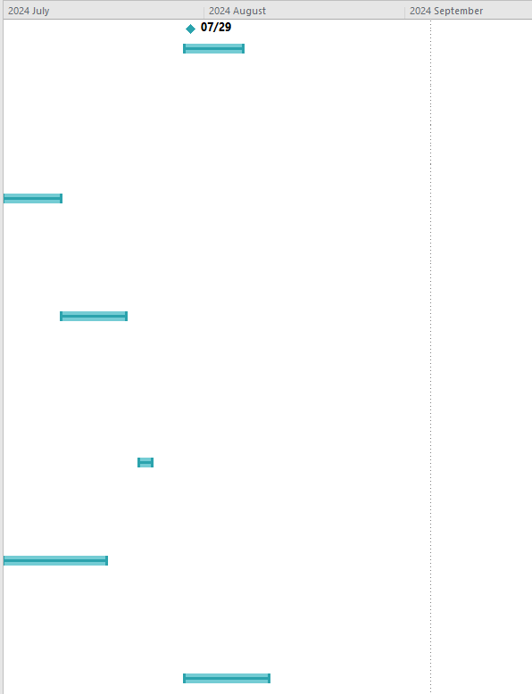
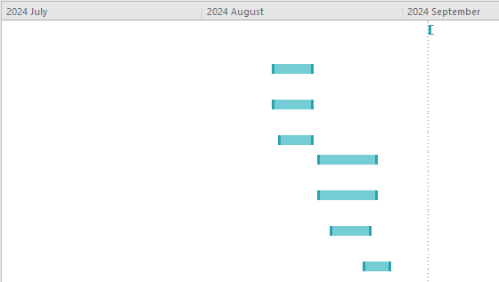
Duration
2. INSTALLATION :
Task
2.1.1
2.1.2
2.2.1
2.2.2
2.3.1
2.3.2
2.1.1 Install switches (5%)
2.1.2 Install routers (5%)
2.2.1 Run fibre cabling (10%)
2.2.2 Terminate fibre cabling (10%)
2.3.1 Install servers (5%)
2.3.2 Install Wi-Fi access points (5%)
2.3.3 Install network components (10%)

Slide 6
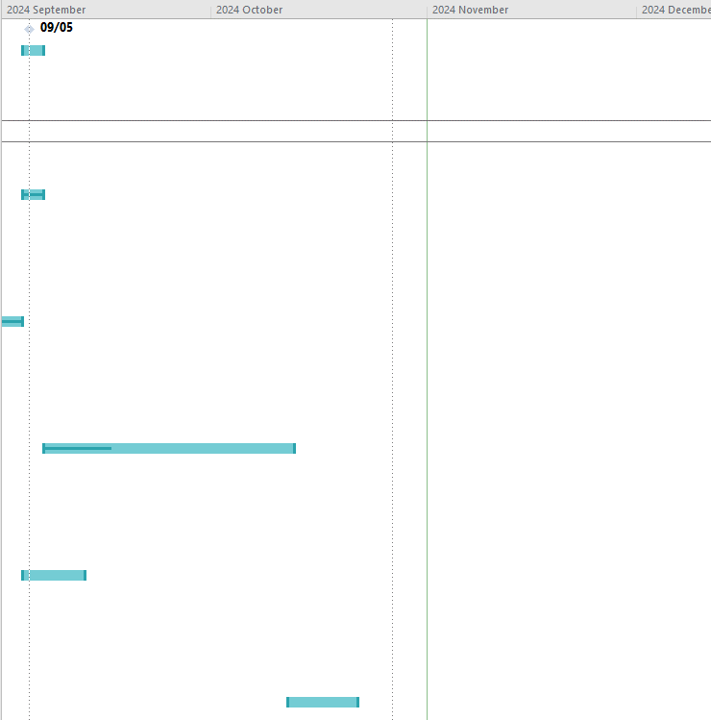
Duration
3. Testing and Commissioning:
Task
3.1.1
3.1.2
3.2.1
3.2.2
3.3.1
3.3.2
3.1.1 Conduct fibre optic testing (5%)
3.1.2 Conduct copper cable testing (5%)
3.2.1 Test network devices (10%)
3.2.2 Test network configuration (10%)
3.3.1 Test network connectivity (10%)
3.3.2 Test network performance (10%)

Slide 7
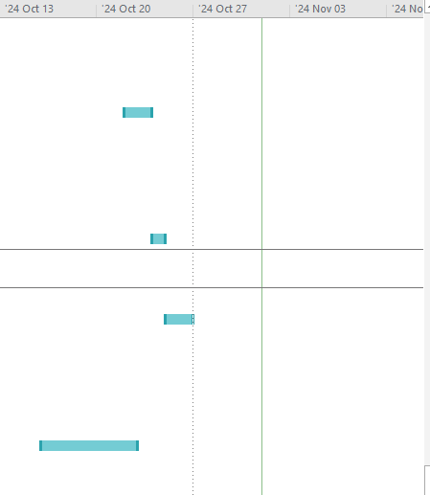
Duration
4. Documentation and Handover:
Task
4.1.1 Create documentation (5%)
4.1.2 Validate network diagrams (5%)
4.3.1 Hand over to airport operations team (10%)
4.3.2 Check detailed cable records (5%)
4.1.1
4.1.2
4.3.1
4.3.2

Slide 8
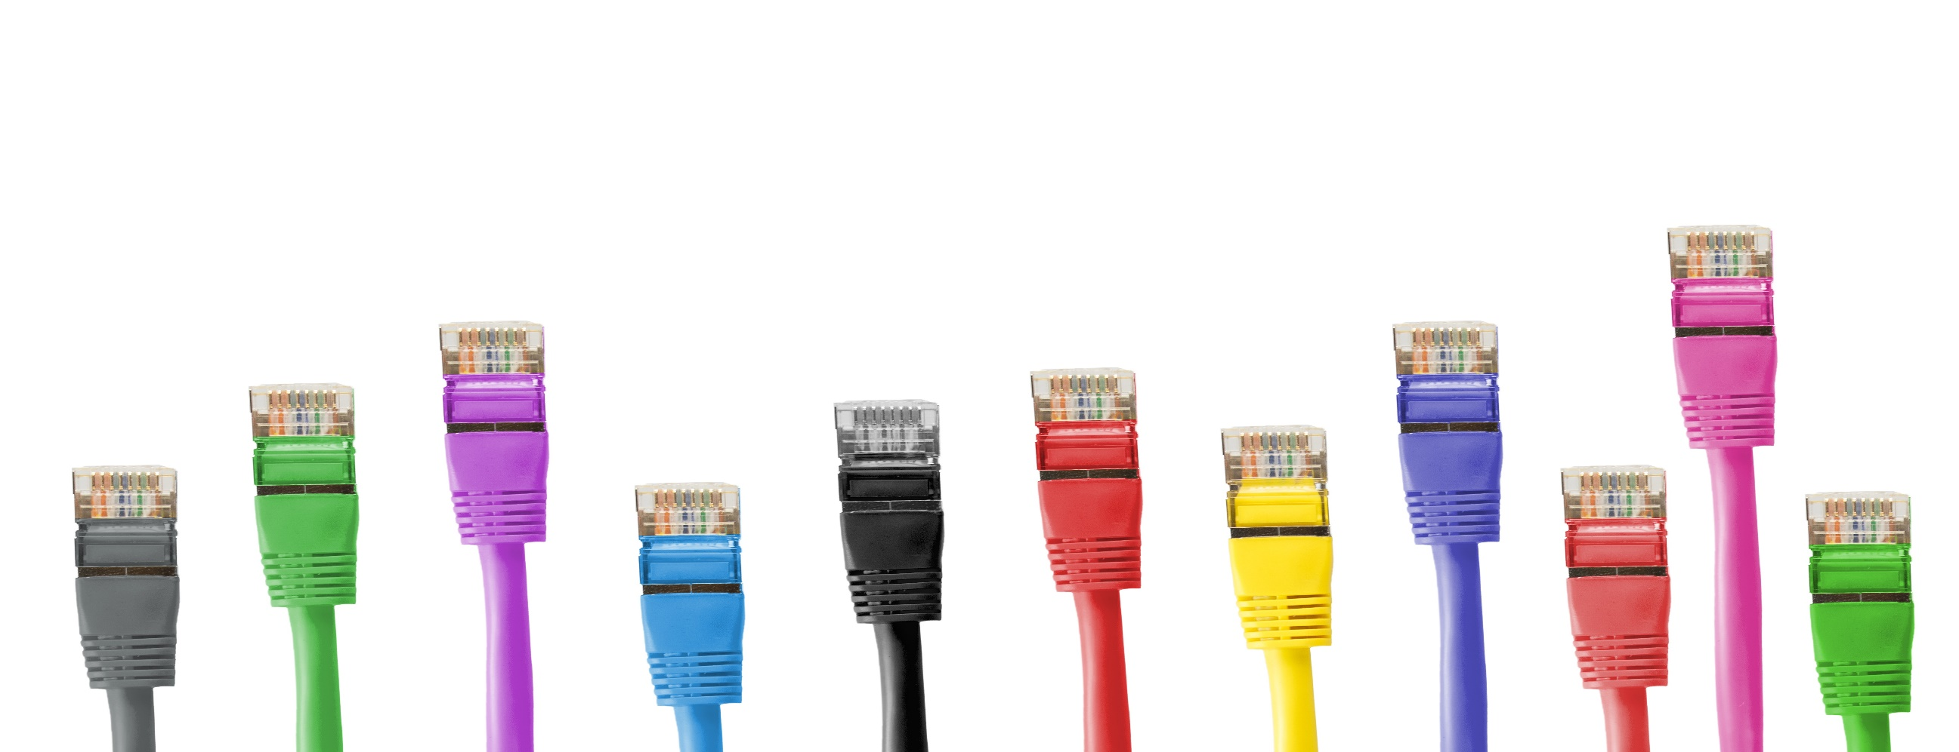
CUT-SHEET

Slide 9
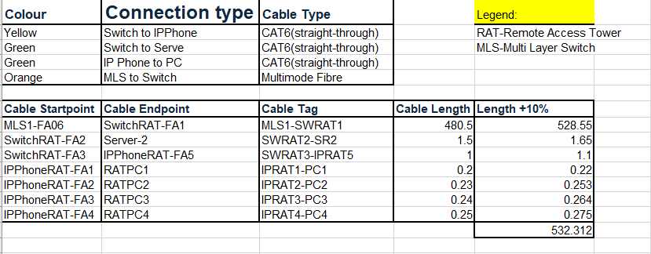
Cut-sheet
REMOTE TOWER
Document used to provide specifications and technical data about a product or piece of equipment
This includes information such as type and measurements

Slide 10
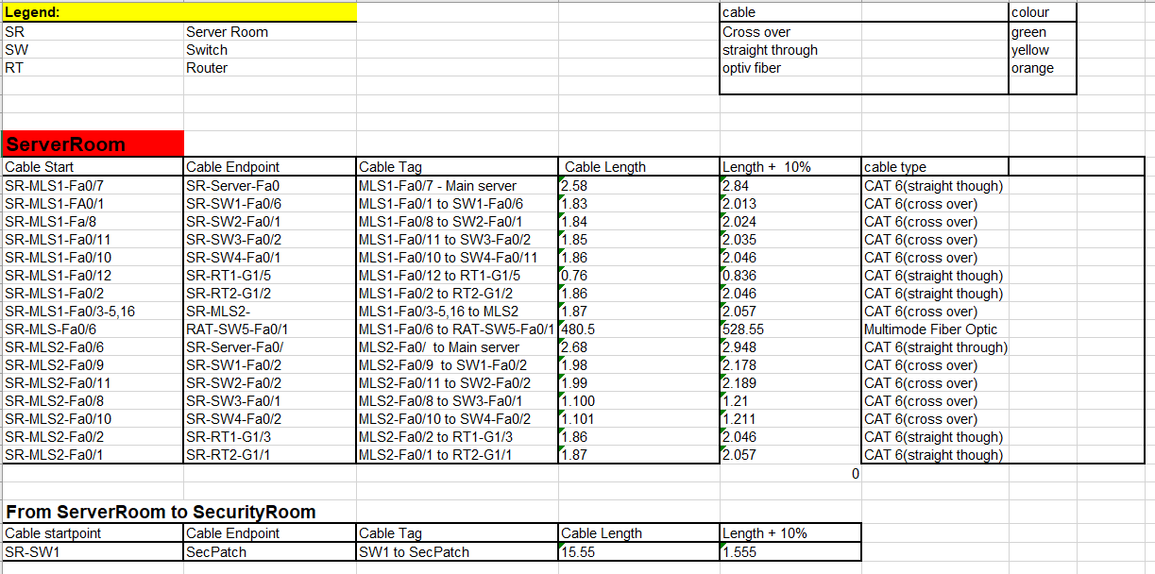
For referencing and convenience
SERVER ROOM
Cable start and end points ae specified
Cable tag
Colour coded cables
+10% Length
Legend

Slide 11


DEVICE LIST

Slide 12
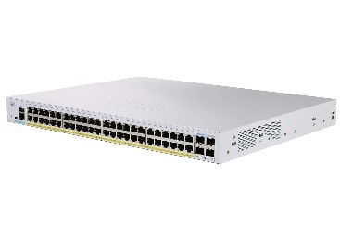
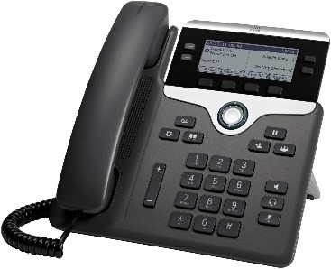
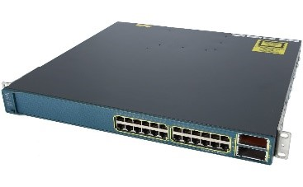
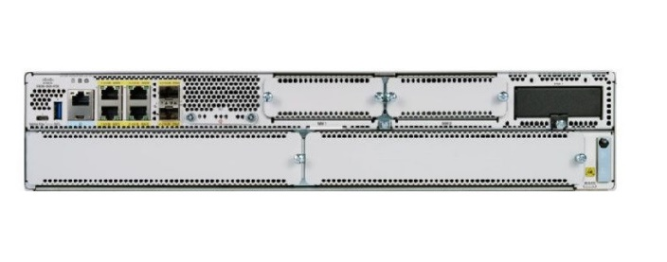
SWITCH
IP PHONE
MULTILAYER SWITCH
ROUTER
CISCO - Catalyst 9400 10G, 1G SFP+ line cards
CISCO - VOIP Phone 7942CP794
CISCO - MDS 9300 Series Multilayer Fabric Switches
CISCO - Catalyst 8300-2N2S-4T2X
2 rack unit, 10G WAN

Slide 13
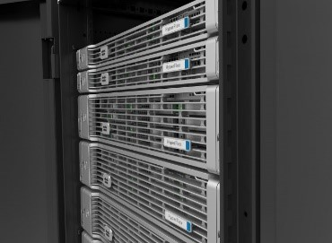
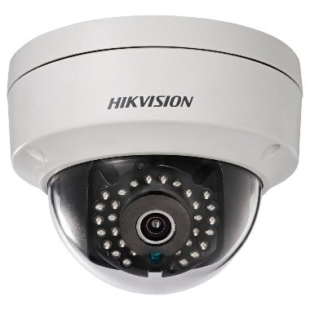
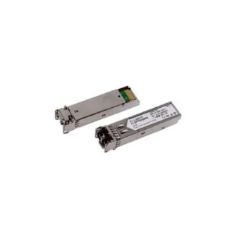
SERVER – CISCO UCS X-Series Modular System
IP CAMERA - HCSC Wireless Ip Security Camera
FIBER -multi mode fiber 1.25g LC Bi-Directional (20km)
delivers rapid scalability and performance to activate data and insights in real time. modular architecture lets right-size infrastructure for the workload and operate with the efficiency and predictable.
This camera provides a full 360-degree view, allowing you to monitor an entire room without blind spots. It supports both Wi-Fi and Ethernet (wired)
Physical connection between the two buildings. Uses thin glass strands and lasers for light generation. Ideal for long-distance communication

Slide 14
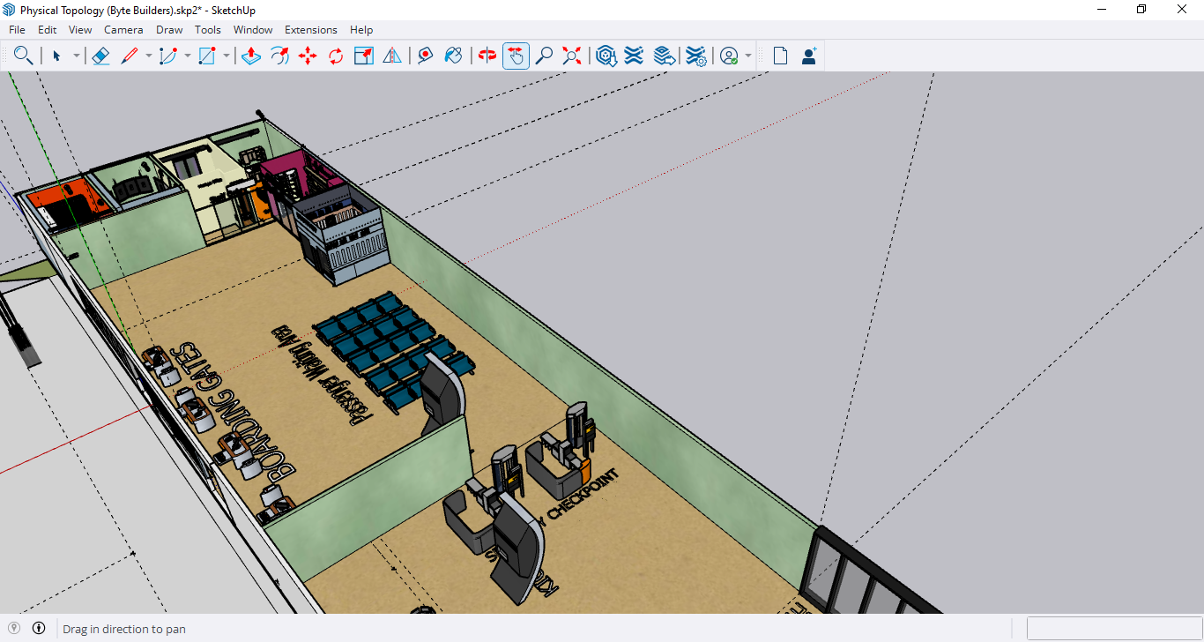
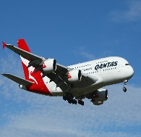
PHYSICAL DIAGRAM
This Photo by Unknown Author is licensed under CC BY-SA
This Photo by Unknown Author is licensed under CC BY
This Photo by Unknown Author is licensed under CC BY-NC-ND

Slide 15
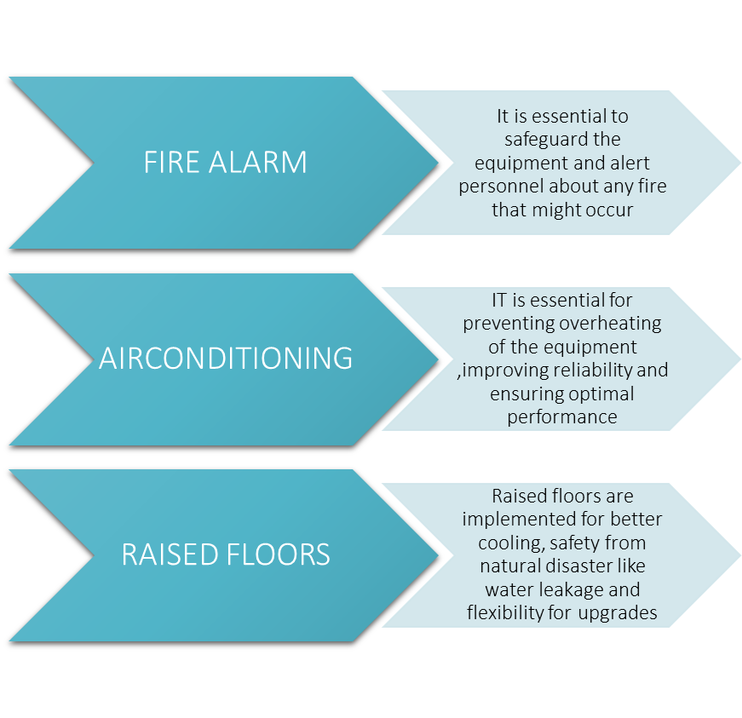
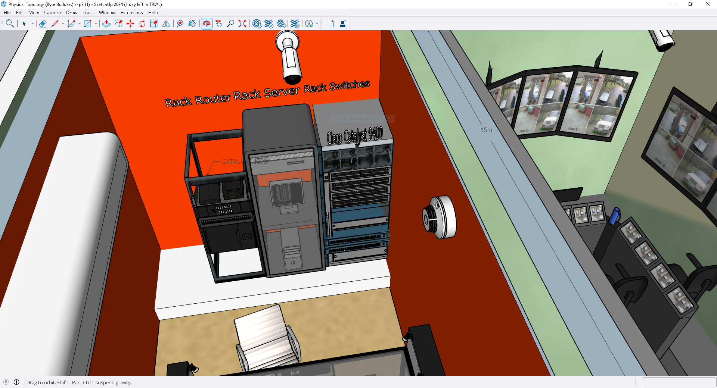
SAFTEY

Slide 16
SAFTEY
IP Cameras
They are essential to regulate who can view and enter certain rooms in the airport
Access Controls
They are essential for enhancing security, monitoring and accountability

Slide 17
LOGICAL DIAGRAM & CONFIGS

Slide 18
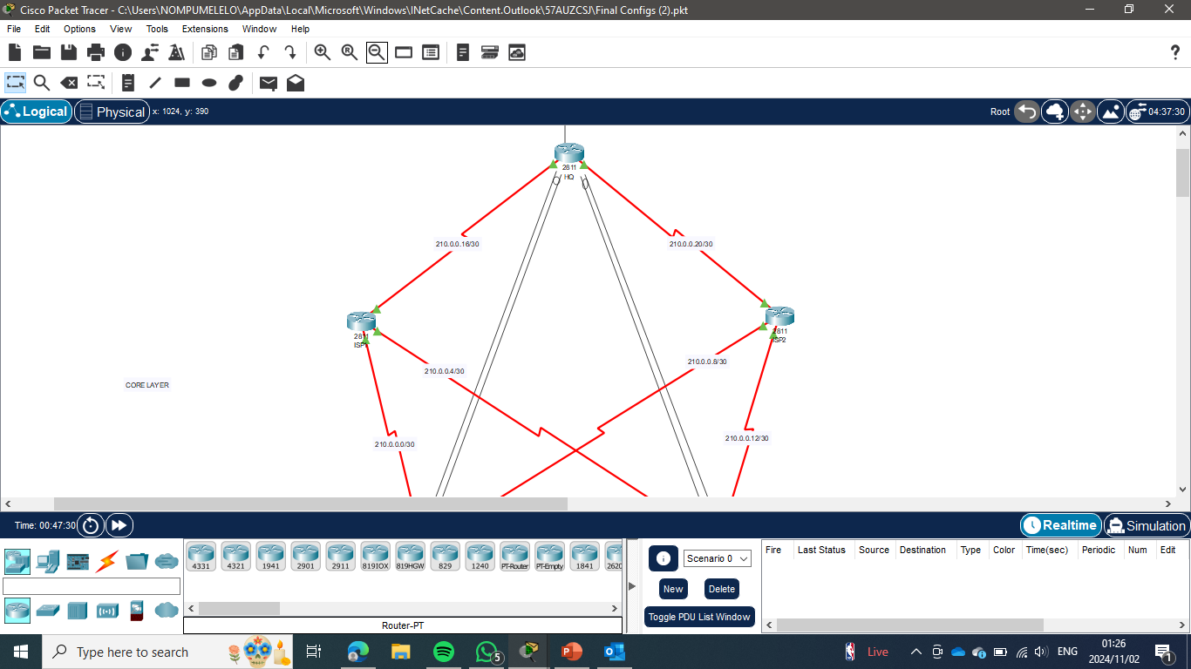
Add a Slide Title - 2
Core Layer
ISPs have static routes, provides connection between the two airports
VPN-Between edge routers and HQ router for secure and encrypted communication between devices.

Slide 19
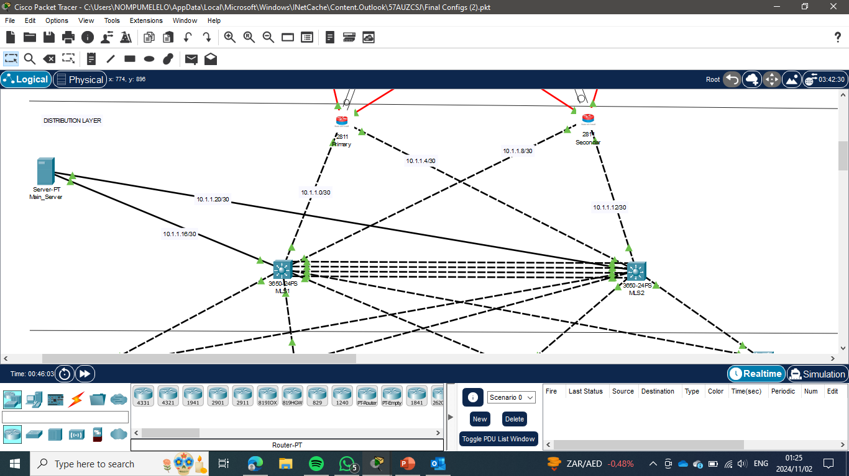
Add a Slide Title - 2
Distribution Layer
EtherChannelling Between the multilayer switches for fault tolerance and load balancing.
Server-DHCP configuration for assigning ip addresses to devices
Multilayer switches with hsrp for redundancy and improved network availability. Intervlan routing
Edge routers-Zone based firewalls, Nat, OSPF

Slide 20
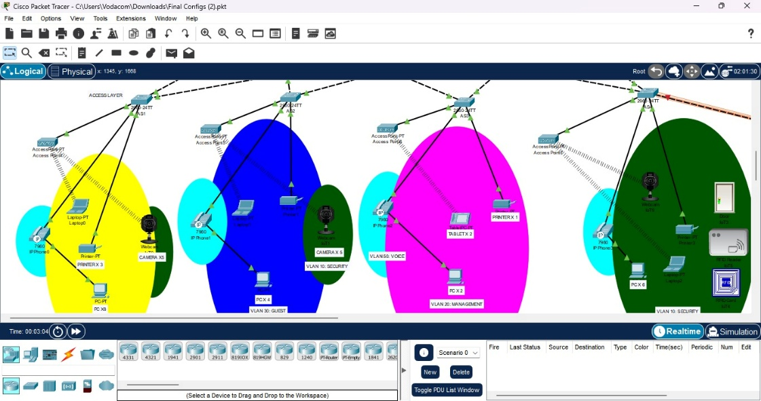
Access Layer
Vlans to segment the network which helps reduce broadcast traffic and improve network efficiency.
Switchport Access on the switches for effective network management, security, and performance optimization.
Wireless connectivity for the mini tablets

Slide 21
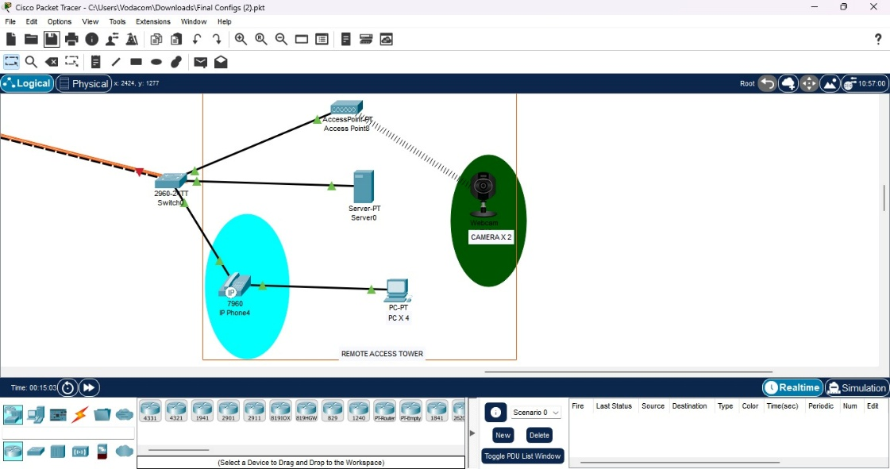
REMOTE ACCESS TOWER
The function of the remote access tower is to control air traffic as it approaches and leaves the airspace around an airport.
To assist the Remote tower to achieve it’s function we have cameras to monitor the airfield and surrounding areas, which can be integrated into the network for real-time viewing and recording.
And VoIP For clear and efficient communication between air traffic controllers and pilots
Establish a physical connection between the Remote Access Tower and the main building, using Fiber optic

Slide 22
Conclusion
The proposed network infrastructure for Uitenhage Airport aims to improve both operations and the passenger experience. First, a secure connection between Uitenhage and PE Airport will facilitate smooth communication and data transfer.
integrated communication systems will help ground staff and the control tower coordinate effectively.
To ensure safety, comprehensive surveillance and access control systems will monitor all areas of the airport.
The design will also allow for future growth, enabling the airport to adapt to new demands over time.

Slide 23
THANK YOU

